Slide 1

Transportation & Air Quality Planning
AMPO MPO Educational Series
November 8, 2012

Slide 2
Purpose of the Session
Provide an overview of air quality and transportation planning requirements for new MPOs and existing MPOs that are new to the topic of air quality planning.

Slide 3

Overview
Clean Air Act
Air quality planning
Transportation Conformity
Resources and
contacts

Slide 4
AQ Terms and Acronyms
National Ambient Air Quality Standards (NAAQS)
Designation
Attainment/Nonattainment/Maintenance
State Implementation Plan (SIP)
Transportation Conformity
Motor Vehicle Emissions Budget (MVEB)

Slide 5

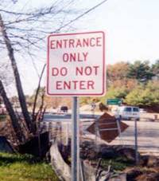
Air Quality Planning is Straightforward

Slide 6
Transportation and Air Quality Planning
Clean Air Act: air quality planning (Title 42)
Transportation planning (Title 23)
Clean Air Act
Title 23
TEA-21
CAA

Slide 7
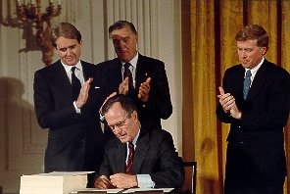
Clean Air Act
Air Pollution Act - 1955
Clean Air Act – 1963, 1970
1977 Amendments
1990 Amendments
  Title I – Urban
  Air Quality

Slide 8
Clean Air Act – Title I
Identifies criteria pollutants and sets National Ambient Air Quality Standards (NAAQS)
  Ozone (O₃)
  Particulate matter (PM)
  Carbon monoxide (CO)
  Nitrogen dioxide (NO2)
  Sulfur dioxide (SO₂)
  Lead (Pb)
Requires urban areas to monitor air quality
{
Transportation related

Slide 9
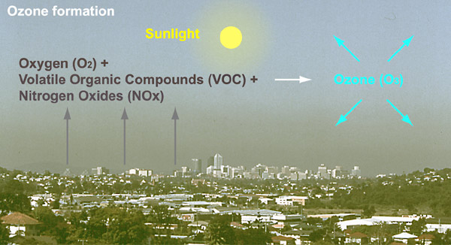
Ozone
Ground level ozone is formed in the atmosphere, not directly emitted
  Volatile Organic Compounds (VOC) and Nitrogen Oxides (NOx) react in the presence of sunlight to form ozone

Slide 10
Ozone Standard
8-Hour ozone standard
  Met when the annual fourth-highest daily maximum 8-hr concentration, averaged over 3 years, is less than 0.075 ppm (primary standard).

Slide 11
Transportation Ozone Emissions
Gasoline and diesel on-road vehicles emit ozone precursors
  NOx – from tailpipe
  VOC - from tailpipe, and from evaporative emissions while car is at rest

Slide 12
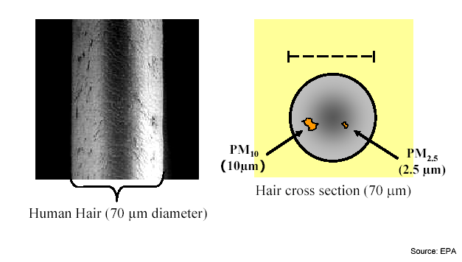
Particulate Matter
Mixture of microscopic solid and liquid particles suspended in air
Can be emitted directly or formed in the air from gases
Two pollutants: PM10 and PM2.5

Slide 13
Particulate Matter Standards
PM10 – particulate matter less than 10 microns in diameter
  24 hour standard: 150 µg/m3 (averaged over each 24-hour period), not to be exceeded more than once per year on average over 3 years
PM2.5 – particulate matter less than 2.5 microns in diameter
  Annual standard: 15 µg/m3 (annual mean concentration averaged over 3 years)
  24 hour standard: 35 µg/m3 (determined by the 3-year average of the 98th percentile of each monitor)
PM2.5 is a different pollutant than PM10, not just a different standard

Slide 14
Transportation Particulate Emissions
Gasoline and diesel on-road vehicles emit:
  Direct PM2.5
    exhaust
    brake and tire wear
    re-entrained dust from paved and unpaved roads
  PM2.5 precursors
    NOx, VOCs, SOx
    ammonia (primarily emitted by gasoline vehicles)

Slide 15
Carbon Monoxide (CO)
Colorless and odorless gas
Forms when carbon in fuel is not burned completely
High concentrations can occur in areas with heavy traffic congestion/idling
Standard
  1-hour standard: 35 ppm
  8-hour standard: 9 ppm
  Both not to be exceeded more than once per year

Slide 16
Air Pollution Health Effects
Ozone
  Wheezing, coughing, chest pain
  Aggravated asthma, reduced lung capacity
  Increased susceptibility to respiratory illnesses
PM
  Chronic bronchitis, asthma attacks, decreased lung function
  Heart attack, premature death
Older adults, children, and people with heart or lung disease are at a higher risk

Slide 17
Air Pollution Health Effects
CO
  High levels lead to vision problems, reduced ability to work or learn, reduced manual dexterity, difficulty performing complex tasks
  At extremely high levels, CO is poisonous and can cause death

Slide 18
Air Quality Planning

Slide 19
Air Quality Planning Process
Designate and
Classify Area
Planning &
Implementing Controls
Monitor
Air Quality

Slide 20
Monitoring Air Quality
Systems of monitors samples and records air quality for a particular pollutant
Measurements are used to establish compliance with the NAAQS
Areas meeting the standard over time are in Attainment
Areas exceeding the standard are designated Nonattainment

Slide 21
Nonattainment Area Classifications
After nonattainment designation, areas are classified (ozone, CO, PM)
  Based on level of monitored air pollution
  Example (ozone): Marginal, moderate, serious, severe, or extreme classifications
  8-hour ozone classification also has Subpart 1 areas
Each classification requires a timeline for attainment and an increasing level of planning and pollution control requirements

Slide 22
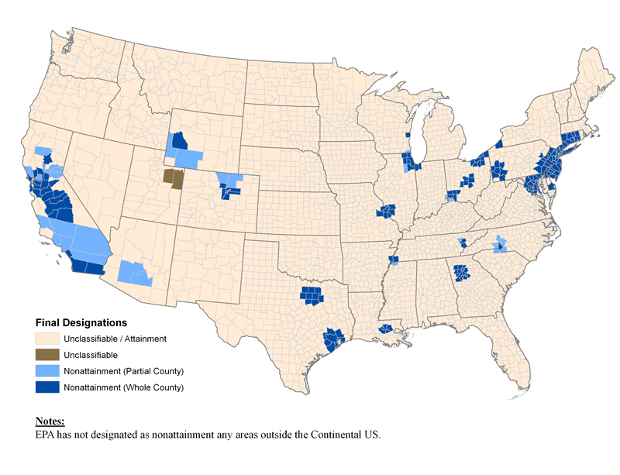
8-Hour Ozone Areas

Slide 23
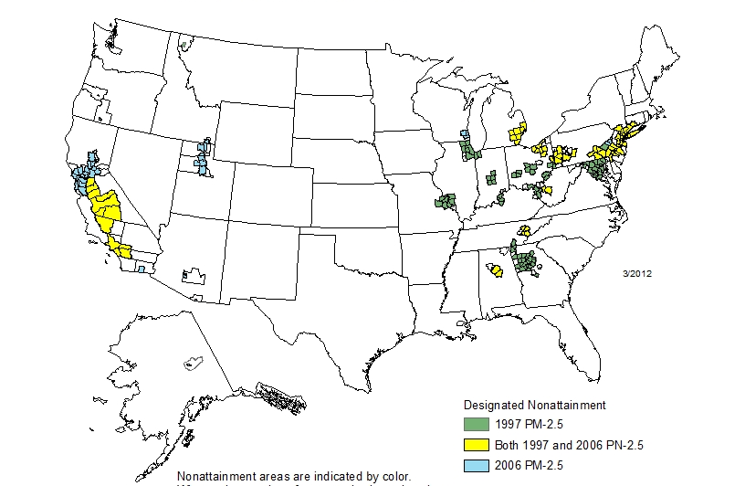
PM2.5 Nonattainment Areas

Slide 24
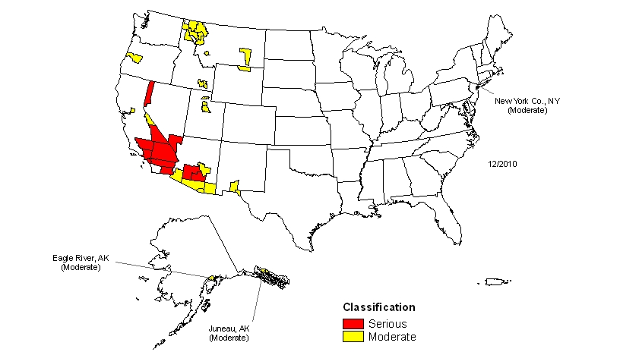
PM10 Nonattainment Areas

Slide 25
What happens after designation?

Slide 26

State Implementation Plan (SIP)
How to meet the standard by the attainment deadline
Collection of documents – planning, regulatory, and procedural

Slide 27
SIP Description
How the state will monitor, control, and enforce the standards
Addresses all emissions sources
For transportation, sets the limit on emissions for on-road vehicles
Addresses the time period up until attainment date (e.g., 2018)

Slide 28
Emission Sources
Point (Stationary) – Large single sources
  Power plants, industrial boilers…
Area – Numerous dispersed sources
  Bakeries, consumer products, auto body repair, breweries, leaf burning, grills, gas stations, house paint…
Mobile – move from place to place
  Onroad – cars, trucks, buses, motorcycles…
  Nonroad – lawnmowers, leaf blowers, construction equipment…
Biogenic – Naturally occurring
  Trees, vegetation, natural forest fires

Slide 29
SIP Emission Inventory
SIP starts with a base year emission inventory
  Total emissions for a pollutant
  Benchmark for calculating future target emission levels
Base year inventory is projected to future years (e.g., attainment year)
  Use socio-economic factors
  Account for existing and new controls and technologies

Slide 30
Example Emissions Inventory

Slide 31
Example Emissions Inventory
2008 NOx tons/day Baseline
2015 NOx tons/day w/Controls

Slide 32
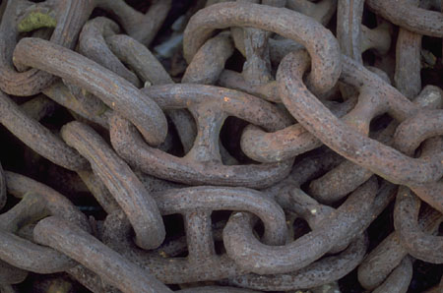
How is Transportation Planning Linked to Air Quality?
In nonattainment and maintenance areas, transportation plans, TIPs, and projects must be in Conformity with the SIP

Slide 33
Transportation Conformity

Slide 34
How are Transportation Plans and TIPS Linked to the SIP?
The SIP establishes a Motor Vehicle Emissions Budget (MVEB) for on-road vehicles
  Ceiling on emissions from highway and transit vehicles
Emissions resulting from implementation of TIP or
Plan must “Conform” to the SIP:
  Transportation projects will not:
    Cause or contribute to any new violation of a standard or delay timely attainment;

Slide 35
Who does conformity?
MPOs, or DOTs outside of metro areas
State air agencies are usually involved
FHWA and FTA approve the conformity determination
EPA has a consultation role on conformity determinations and determines if SIP budgets are “adequate”

Slide 36
What transportation actions are subject to conformity?
Long Range Transportation Plans
Transportation Improvement Programs
“Federal” projects
  projects receiving federal funding
  projects receiving FHWA/FTA approval
Regionally significant non-Federal projects are partially affected

Slide 37
Key Elements of a Conformity Determination
Regional emissions analysis
Transportation modeling
Latest planning assumptions and emissions model
Interagency consultation
Public participation

Slide 38
Conducting a Regional Emissions Analysis
Determine which conformity emissions test(s) apply
Determine analysis years for evaluation (as specified by conformity rule)
Model/estimate VMT
Calculate emissions from this VMT
Compare emissions in each analysis year to the applicable emission test

Slide 39
Estimating Travel Demand (VMT)
VMT is estimated using either
  a network travel demand model
  appropriate methods that account for VMT growth
Some areas are required to have a network travel model for conformity
All other areas use best professional practice

Slide 40
Calculating Emissions from VMT
Need:
  Latest emissions factor model (MOVES in 49 states, EMFAC in CA)
  VMT estimates, from previous step
  Other factors that influence emissions, e.g.:
    Vehicle speeds
    Composition of vehicle fleet (trucks, cars, diesel, gas…)
    Other latest planning assumptions needed by emissions model (e.g., min/max temperatures)

Slide 41
Meeting the Emissions Test
If the tests aren’t passed, must do one or more of the following:
  change projects
  change timing of projects
  Implement emission control measures
  Revise SIP budgets if using budget test

Slide 42
Overview of Regional Emissions Analysis
Emission
Factors
VMT Estimation
MOBILE or EMFAC
On-Road Vehicle Emissions Inventory
Off-Line Calculations
Regional Emissions Analysis
Emission test comparisons

Slide 43
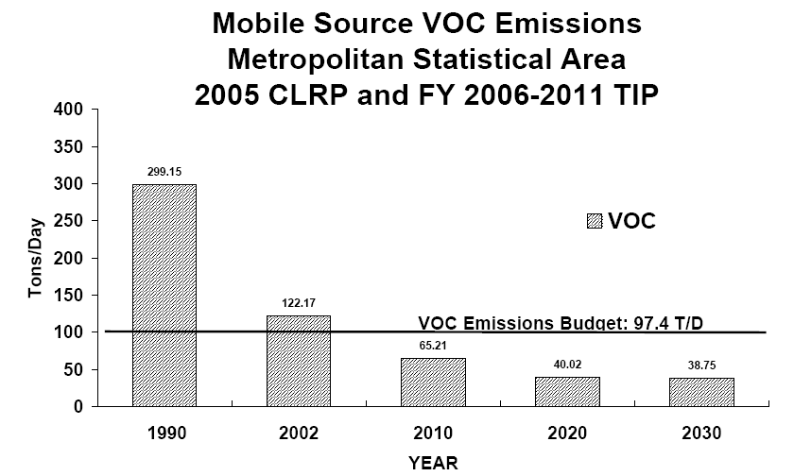
Conformity Example

Slide 44
Conformity Example

Slide 45
What happens if conformity is not demonstrated?
If the transportation plan or TIP do not demonstrate conformity by the established time frames, the area will lapse...
No new plans, TIPs or projects can be adopted or approved until:
  the plan and TIP are changed; or
  the SIP is changed

Slide 46
What projects move forward during a lapse?
Exempt projects
Federal project phases that received final approval before the lapse (e.g., right of way)
Regionally significant non-federal projects that received all final state and local approvals before lapse
Traffic signal synchronization projects
TCMs in approved SIPs
Non-regionally significant non-federal projects

Slide 47
When must conformity be done?

Slide 48
Plans and TIPs: Conformity Triggers
CAA and conformity regulations require:
  New plan/TIP conformity at least every 4 years in nonattainment and maintenance areas
  Conformity analysis on TIP and Plan required within one year of nonattainment designation

Slide 49
Plan and TIP Revisions
A plan/TIP revision and a conformity determination is needed when:
  adding years to plan/TIP
  adding projects to plan/TIP
  significantly changing project(s) in plan/TIP
  shifting timing of projects, e.g., moving project from a later year to an earlier year
    Exception: projects in the first 3 years of TIP can be shifted within the first 3 years without a new conformity determination

Slide 50
  Other Topics

Slide 51
Interagency Consultation
Each area must establish procedures for consultation between involved parties:
  MPOs
  State and local air agencies
  State and local transportation agencies
  EPA
  FHWA/FTA
Consult on development of SIP, plan, TIP, and conformity determinations

Slide 52
Public Participation
Conformity rule relies on public participation
Requires all information for conformity determination to be available at the beginning of the comment period

Slide 53
Conformity Resources
USDOT http://www.fhwa.dot.gov/environment/air_quality/conformity/
USEPA http://www.epa.gov/oms/stateresources/transconf/index.htm
National Transit Institute (www.ntionline.com)
  Introduction to Transportation/Air Quality Conformity
AMPO: Rich Denbow
rdenbow@ampo.org

Slide 54
Questions?

